Slide 1
FAME TAILOR YOUR GAME TRAILER
A presentation about viral Game Trailer marketing

Slide 2
ANATOMY OF A VIDEO GAME TRAILER
ESRB and Disclaimers
Attention Grabbing Hook (Hey everyone look at me!)
Game Title/Company Logo (Establish your brand)
Trailer Body (Source Footage, Cutscenes, Narrative, Key Features, Endorsements)
Closing Punch (Footage to seal the deal)
Title Screen and Marketing Information
Example Trailer

Slide 3
ESRB AND DISCLAIMERS
It is a legal requirement to post ESRB rating before ads for your video games. Not doing so could put you at risk and market platforms like Steam require it. (esrb.org)
Any legal disclaimers should also be put before or after your trailer.

Slide 4
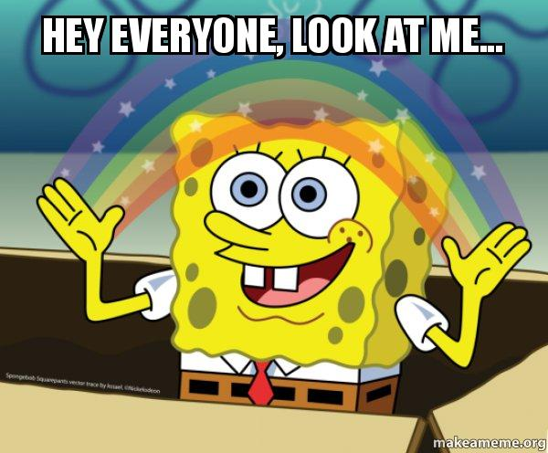
ATTENTION GRABBING HOOK
First 10 seconds are the most important part of your trailer!
Do not monetize your game trailer
Amazing graphics
Professional voiceover
Upbeat and/or dramatic music
Witty, humorous, or shocking opening narrative

Slide 5
GAME TITLE/COMPANY LOGO
Ensure you have professional or clean looking art for your logo. If you don’t, ensure your logo is so bad that it is meme worthy.
Display no longer than 3-5 seconds.
Bonus points for animated logos.

Slide 6
TRAILER BODY
In preparation, record your game constantly during the final months of testing to maximize the amount of source footage you have to draw upon.
Every game is different, so every marketing approach should be unique. Emulating existing form and structure is good, but make it your own.
Keep your game trailer in the back of your mind during your entire game development process. (Assets and marketing ideas)
Find your video theme. If your game is an RPG, use your story narrative to drive your trailer. If your game is a PvP FPS, find amazing moments in source footage to sell your game.
Don’t be frugal with your footage.
Find the humor. Comedy is memorable.
Shock your audience if you can.
Professional voiceover

Slide 7
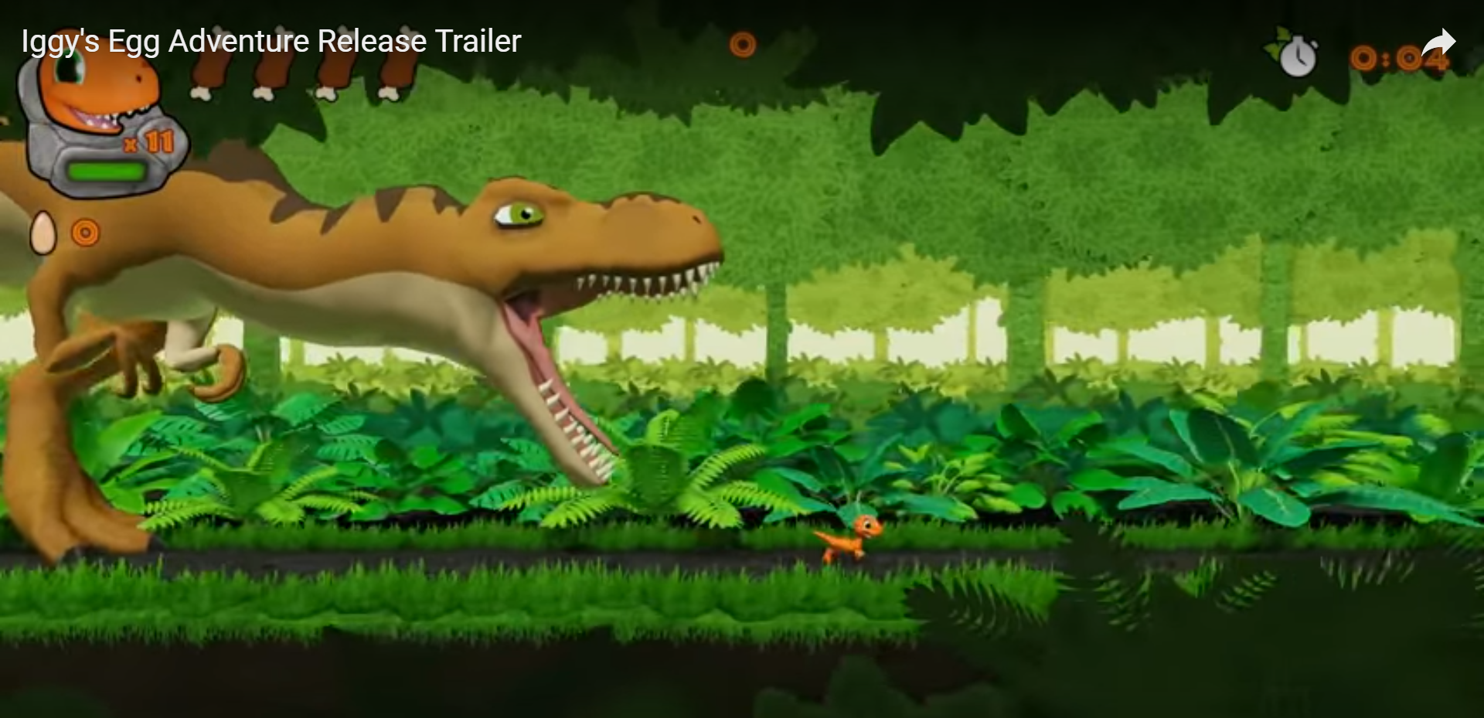
CLOSING PUNCH
Your last chance to seal the deal. Create a memorable few seconds.
Convey something epic, hilarious, or form a perfectly tuned summary of your game and its goal.

Slide 8
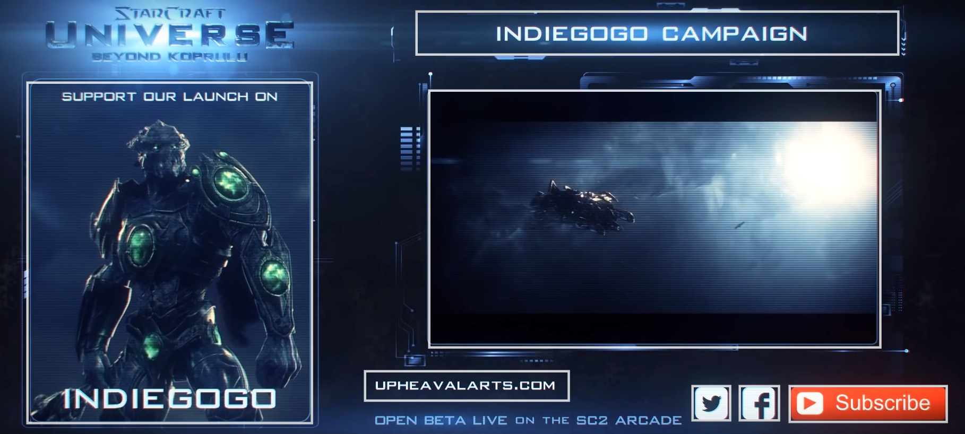
TITLE SCREEN AND MARKET INFO
Title screen again
Release date
Company name
Company website
Social Media
Subscribe button
Use Annotations!

Slide 9
USE THE TOOLS YOU KNOW
Photoshop for text and graphic design.
OBS Studio for screen recording.
Blender for motion design and editing.
If you’ve never made any video before, now might not be the best time to learn. Find a professional!

Slide 10
SMALL BUDGET QUICK TRAILER
3-5 days production time.
Browse all of your game assets and throw anything you think could be used in a game trailer in a folder. UI/Sound/Art/VFX
Record an entire run through of your game, dividing up the videos and labeling them in a folder.
Purchase the license to or create music that you think will reflect your game well.
Sit there and listen to that music on loop and stare at your game assets and source footage until something comes to you.
Layer video cuts on top of the music. Time the pacing of your video cuts to the counts in the music. This will create an automatic audio/visual synergy.
Highlight game feature text and/or voiceover with matching visuals.
Save the best cut for last then display title screen and marketing information.
Small Budget Example Trailer

Slide 11
MARKET YOURSELF
Marketing yourself can be just as important for an indie developer as marketing your game.
Tell people your story as it relates to game development.
If you don’t think your personality is very marketable, tell your story as a narrative through voiceover.
Write a script and layer related video over the dialogue.
Example of self marketing

